Slide 1
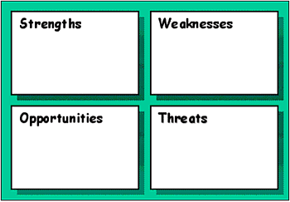
Internal Assessment: Organizational assets, resources, people, culture, systems, partnerships, suppliers, . . .
External Assessment: Marketplace, competitor’s, social trends, technology, regulatory environment, economic cycles .
Figure L-1. SWOT Matrix

Slide 2
Processes
Review internal processes | Organizational process
Examine information systems | Customer management process
Evaluate facilities and equipment | Relationship management process
Assess the skills and experience of the team | Innovation and technology process
Coordinate internal capabilities | Communication process
Determine areas for improvement | Productivity process

Slide 3
Assessment Model: SWOT
Internal Assessment: Organizational assets, resources, people, culture, systems, partnerships, suppliers, . . .
External Assessment: Marketplace, competitor’s, social trends, technology, regulatory environment, economic cycles .
SWOT
Good Points
Possible Pitfalls
What’s happening
externally that affects
the organization?
Easy to understand
Apply at any level
Analytical and specific
Honest about
your weaknesses
What’s the competitions strength
and weakness?
Opportunities
Strengths
Weaknesses
Threats
CURRENT STATE
DEFINE
MODEL
AND
DESIGN
BUILD AND VALIDATE
EXECUTE
MEASURE

